Slide 1





PETPALACE
Your One Stop Destination for buying and selling pets

Slide 2
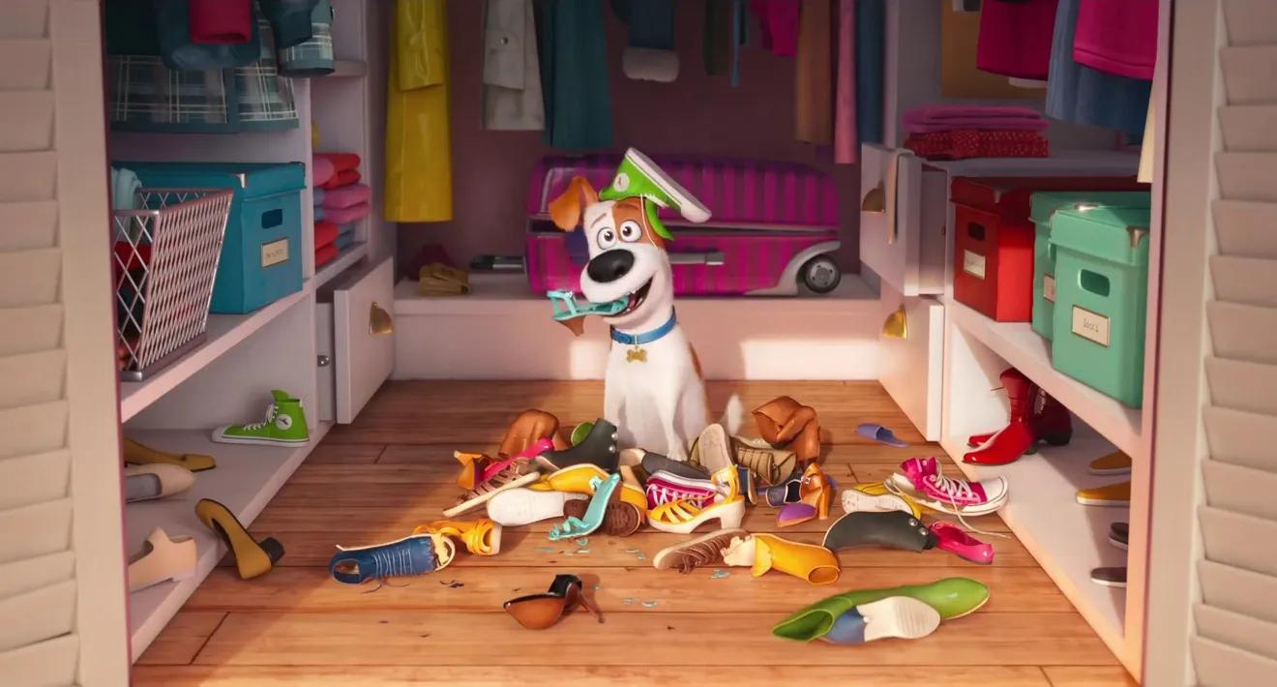
PetPalace
Team Members
Gaurav Shirore
240343020038
Shreya Mutsuddi
240343020094
Vrushabh Mahajan
240343020108
Jayesh Talole
240343020043
Guided by:
Mrs.Bakul Joshi

Slide 3


TABLE OF CONTENT
01 : Introducton to PetPalace
02 : Problem Statement
03 : Overview
04 : Admin Interface
05 : Seller Inteface
06 : Buyer Interface
07 : System Architecture
08 : ER Diagram
09 : Conclusion
10 :Future Scope

Slide 4
INTRODUCTION TO PET PALACE
The current market lacks a centralized platform for pet enthusiasts to find, match, and purchase pets and related supplies. Pet owners and potential pet owners often face difficulties in locating authorized pet shops, finding pet matches, and purchasing specialized pet supplies. This system aims to streamline these processes, providing a user-friendly interface for finding pets, matching pets, purchasing supplies, and locating pet clinics.

Slide 5
MAIN GOALS
• To develop a website that allows users to find pets based on their city and preferences.
• To implement a matching system for pet owners seeking to match their pets with others.
• To provide a platform for purchasing pet supplies tailored to specific pets.
• To help users locate pet clinics in their city.

Slide 6
PROBLEM STATEMENT
The growing demand for pet-related products
and services, coupled with the increasing
number of pet owners, necessitates a
convenient platform that can cater to their
needs. Many pet owners face challenges
in finding a reliable and diverse range of
pet supplies, food, accessories, and
services such as grooming or veterinary care.
Traditional pet stores have limitations in
inventory, location, and availability of products,
while pet owners also have to deal with the
inconvenience of frequent visits to different
shops.

Slide 7
OVERVIEW
The platform focuses on providing:
A diverse product catalog: Featuring items for different types of pets (dogs, cats, birds, fish, etc.).
User-friendly shopping experience: With search filters, personalized recommendations, and secure payment options.
Convenience: Doorstep delivery and scheduling of pet services.
Pet profiles: Users can create and manage profiles for their pets to receive tailored product suggestions and service reminders.

Slide 8

Login Process
User Management
ADMIN INTERFACE
Seller Management
Managing Acoounts
Generating Report
Ensuring System Security

Slide 9
Creating and Managing Account
Seller Login
SELLER INTERFACE
Add Products and Pets
Update Product and Pets
Delete Products and Pets
View Orders

Slide 10
Creating and Managing Account
Buyer Login
BUYER
INTERFACE
Pet Match
Purchase the Pet
Find the Pet Clinic

Slide 11
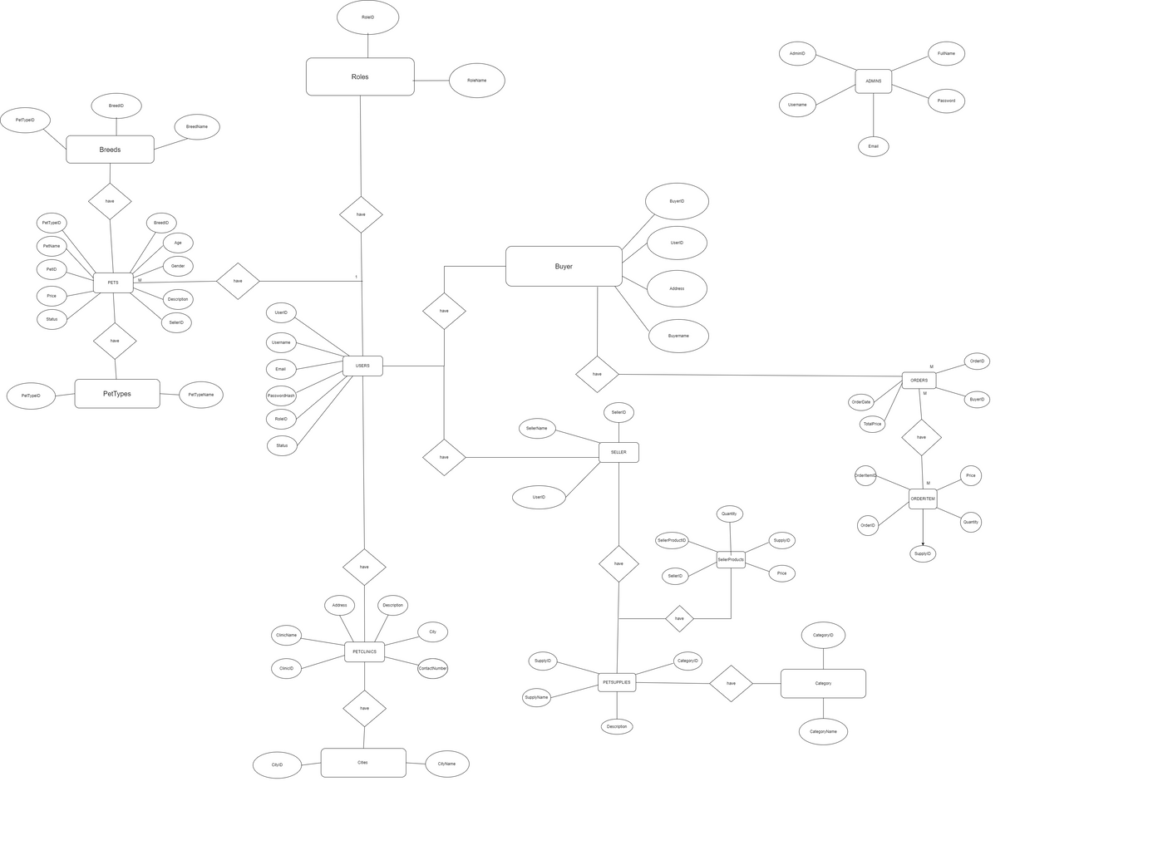
ER Diagram
Creating and Managing Account
Buyer Login
Pet Match
Purchase the Pet
Find the Pet Clinic

Slide 12
System Architecture
•Frontend (User Interface):
•React.js: The frontend is built using React.js, providing a responsive and user-friendly interface for both Seller and Buyer. It allows users to interact with the platform, view product listings, manage accounts, and perform transactions.
•User Roles:
•Buyer Dashboard: Interface for Buyer to list products, view prices, Browse Product and manage transactions.
•Seller Dashboard: Interface for wholesalers to Add products, Update Product , and manage orders.

Slide 13
System Architecture
•Backend:
•.NET Core: Handles user authentication and registration. It provides secure login functionality and manages user sessions.
•Spring Boot: Manages the core functionalities of buying and selling, including product management, order processing, and transaction handling.
•Database:
•MySQL: A relational database stores user information, product listings, transaction histories, and other critical data. The database is structured to ensure efficient data retrieval and storage.
•APIs:
•RESTful APIs: Enable communication between the frontend and backend. They handle requests for data retrieval, user actions, and other interactions between the different modules.

Slide 14

CONCLUSION
The Online Pet Shop System provides a modern, user-friendly platform that addresses the diverse needs of pet owners by offering a wide range of products and services at their fingertips. By combining convenience, personalized recommendations, and accessibility to essential services, it eliminates the hassle of visiting multiple stores and service providers

Slide 15


FUTURE SCOPE
Pet Adoption: Include a section where users can adopt pets from local shelters.
Eco-Friendly Options: Offer more environmentally friendly products and green delivery methods.
Health Management: Allow pet owners to store and manage their pet’s health records and get reminders for vaccinations or treatments.

Slide 16

THANK YOU

